Slide 1


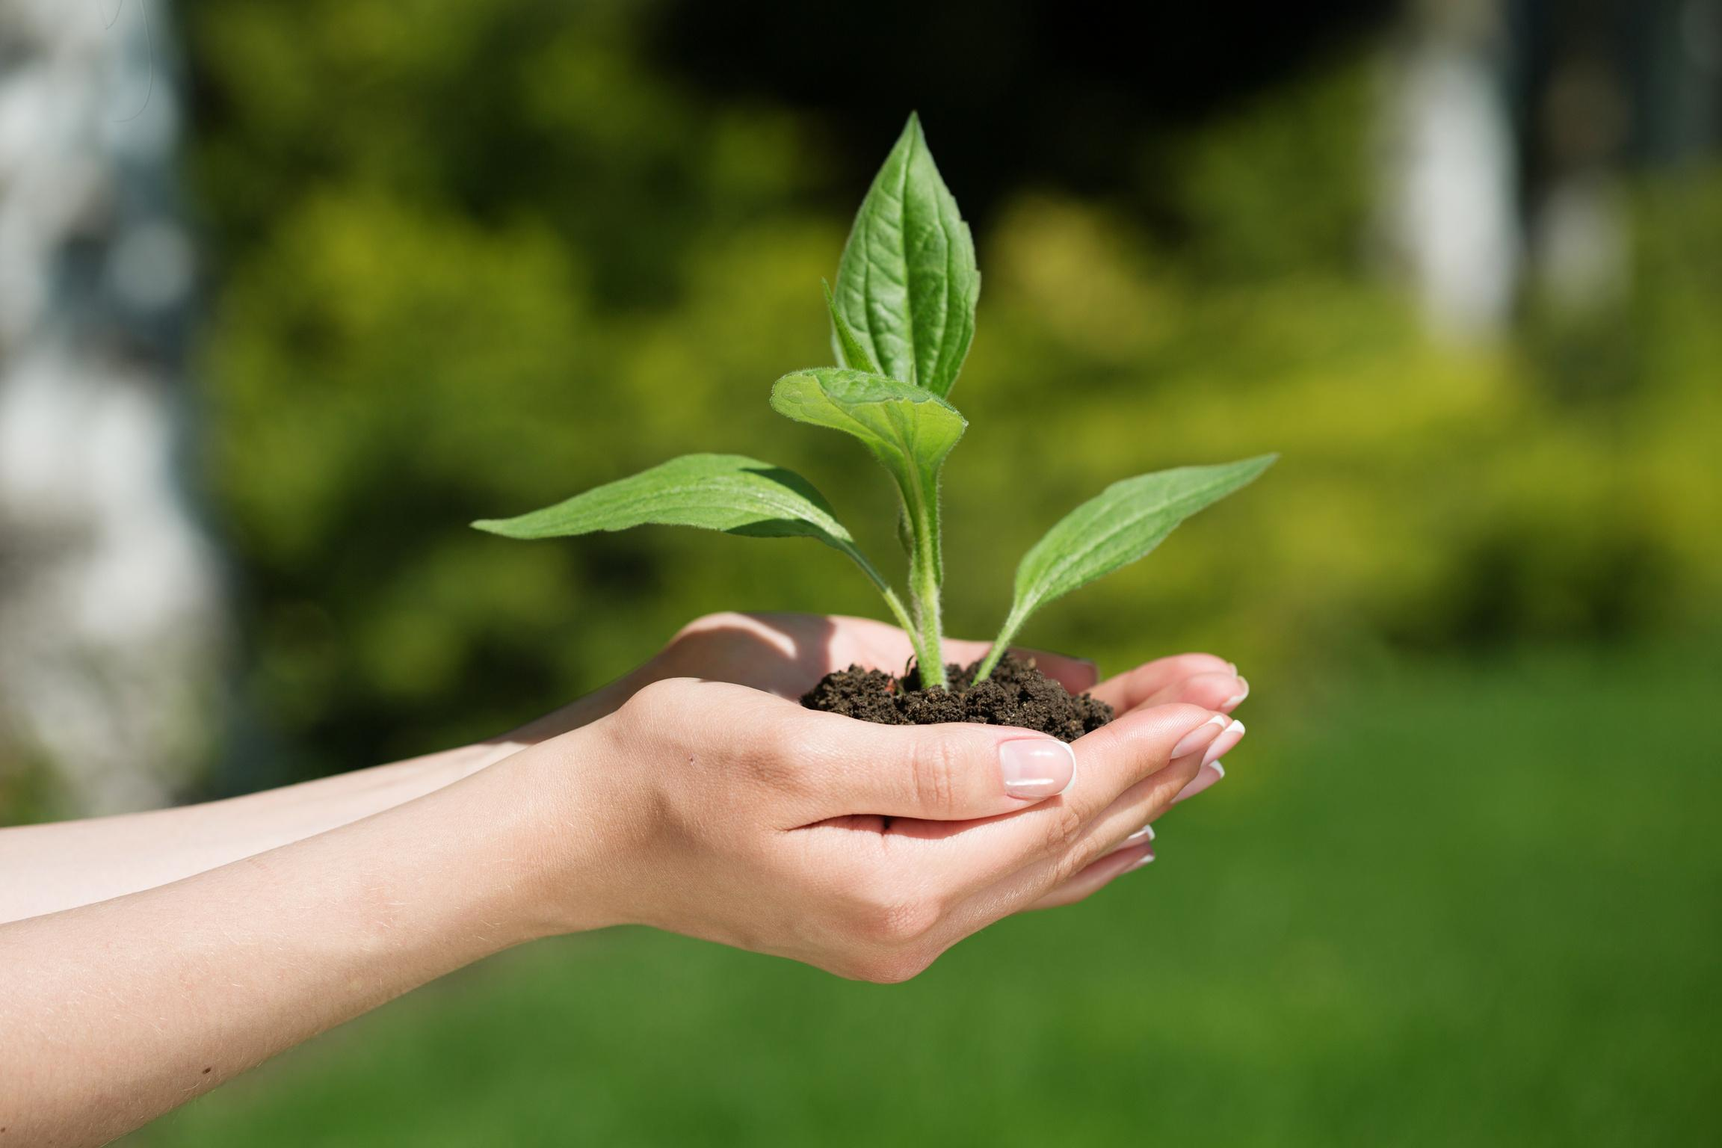
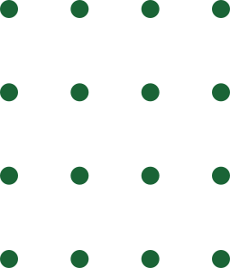

LEAFGUARD:
AI for Smarter Farming
A Plant Disease Detection App for Food Security

Slide 2

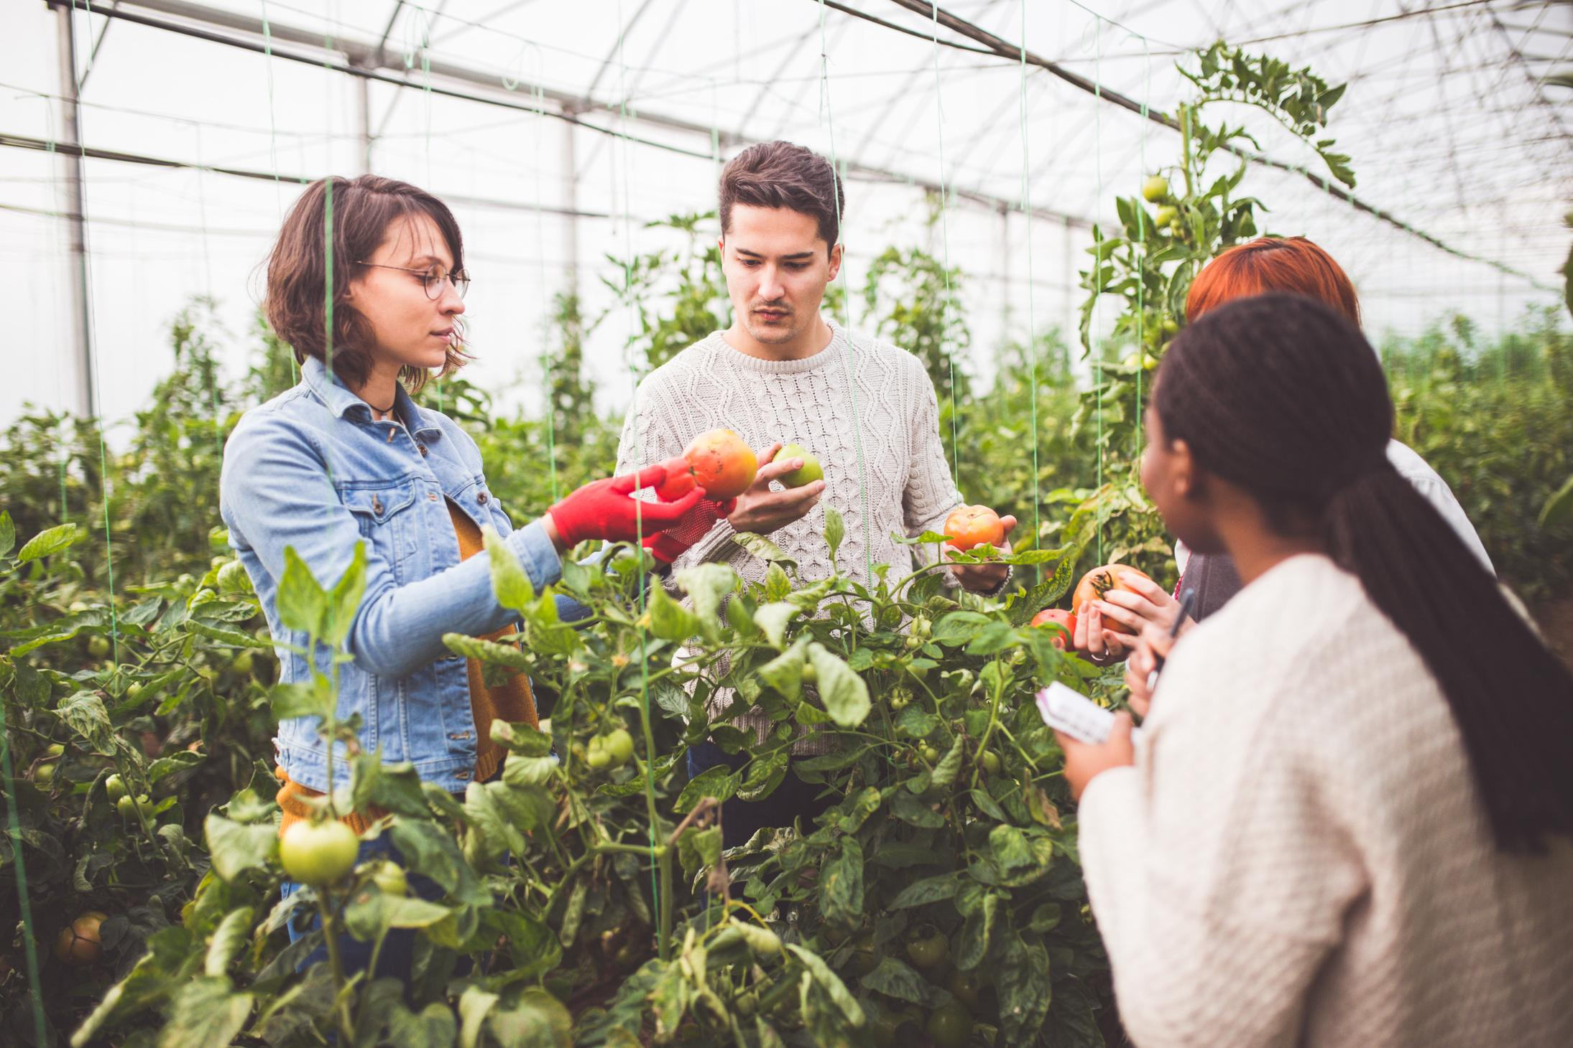

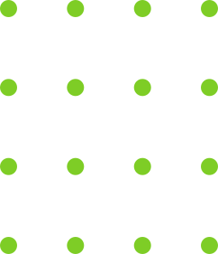
THE PROBLEM:
The Challenge
Crop diseases destroy up to 30% of harvests in low-income farming communities.
Many smallholder farmers lack access to early detection tools and expert support.
This results in reduced food security and economic losses, especially in rural and township areas.

Slide 3
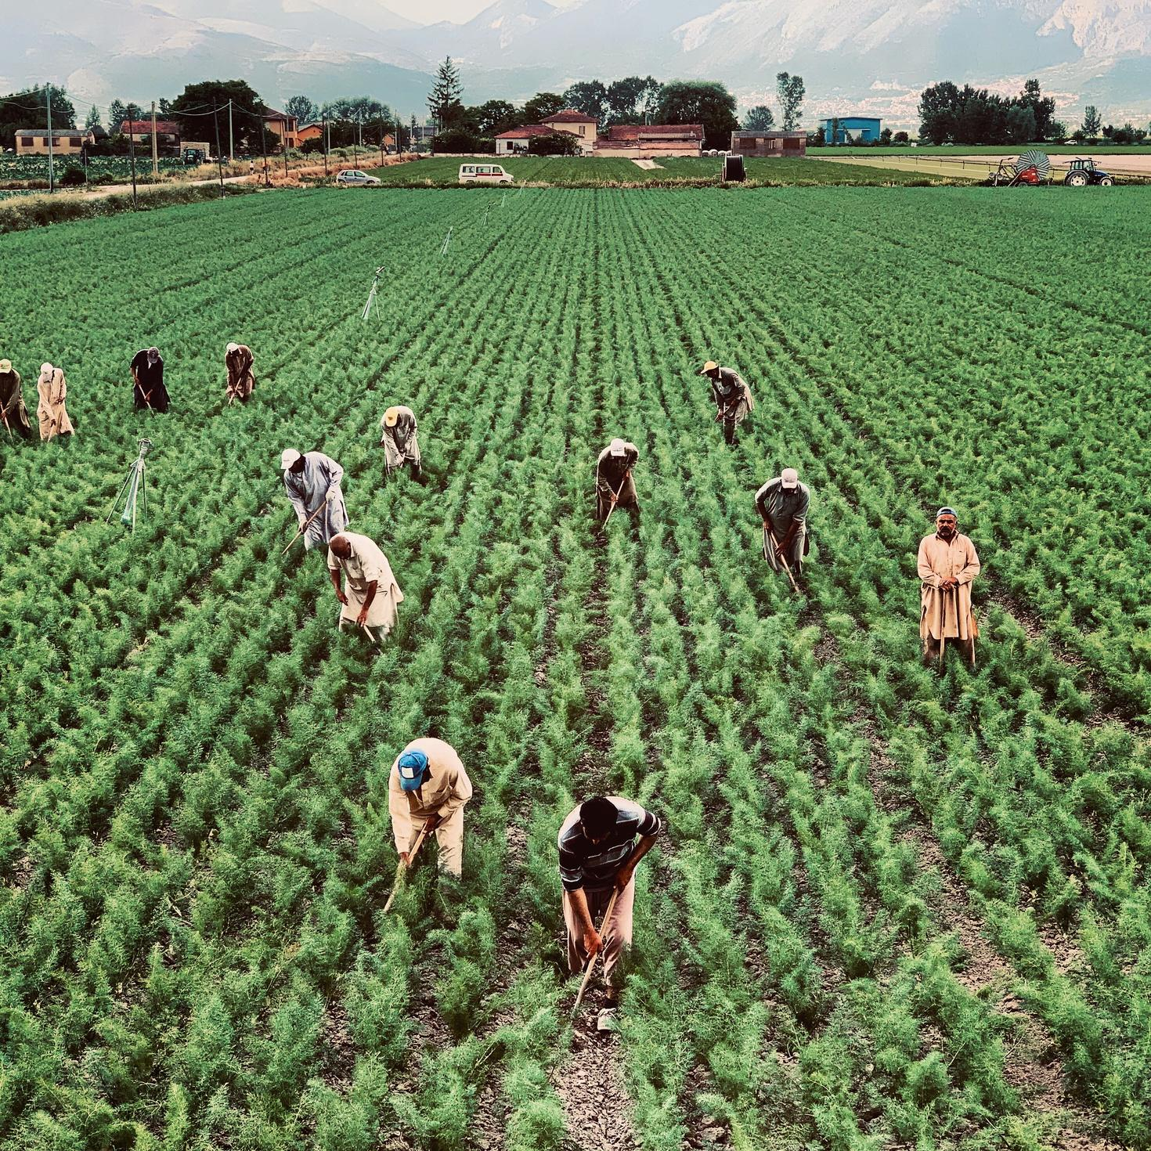
SDG ALIGNMENT:
United Nations SDGs
SDG 2 – Zero Hunger
SDG 1 – No Poverty
SDG 3 – Good Health and Well-being
SDG 9 – Industry, Innovation, and Infrastructure

Slide 4
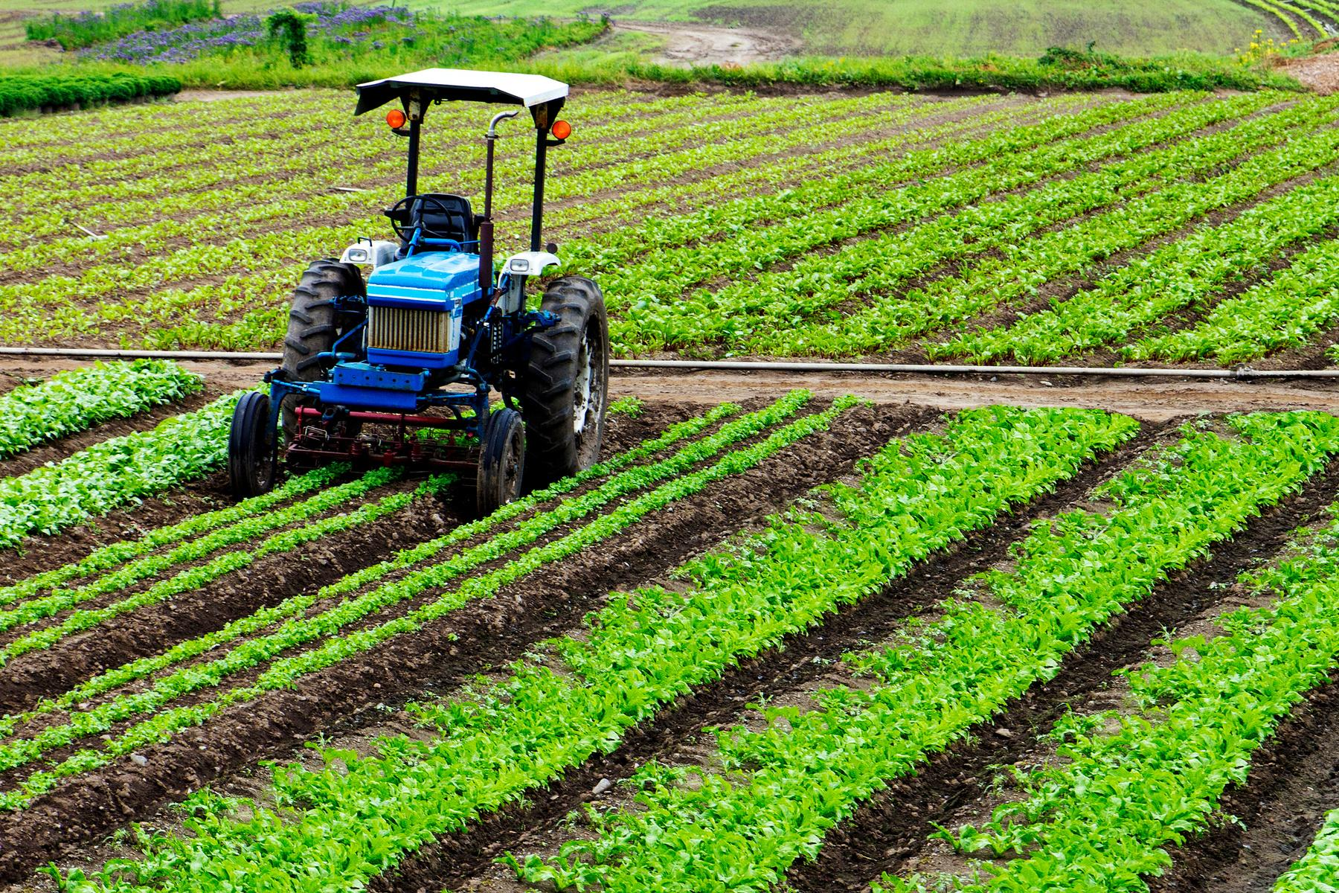
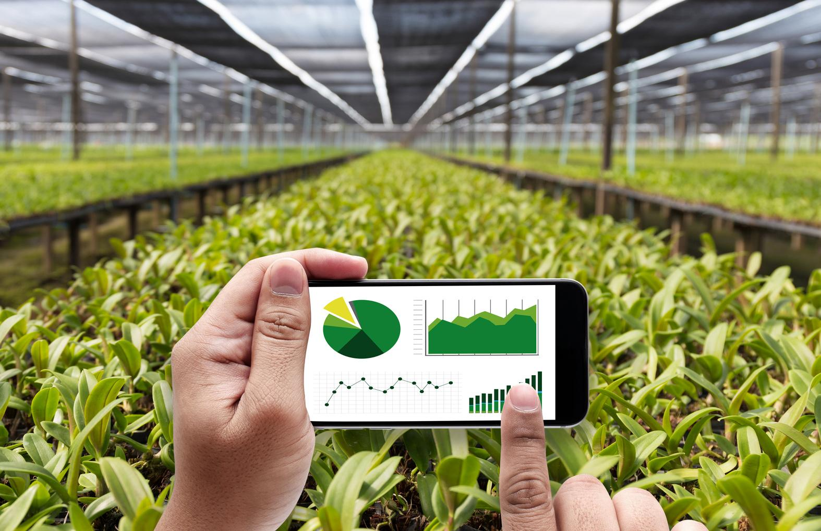

OUR SOLUTION
Introducing LeafGuard
An AI-powered web application that helps farmers detect plant diseases early using just an image of a leaf.
Upload plant leaf image
AI analyzes and predicts disease (simulated for now)
Farmer receives instant feedback for early intervention

Slide 5
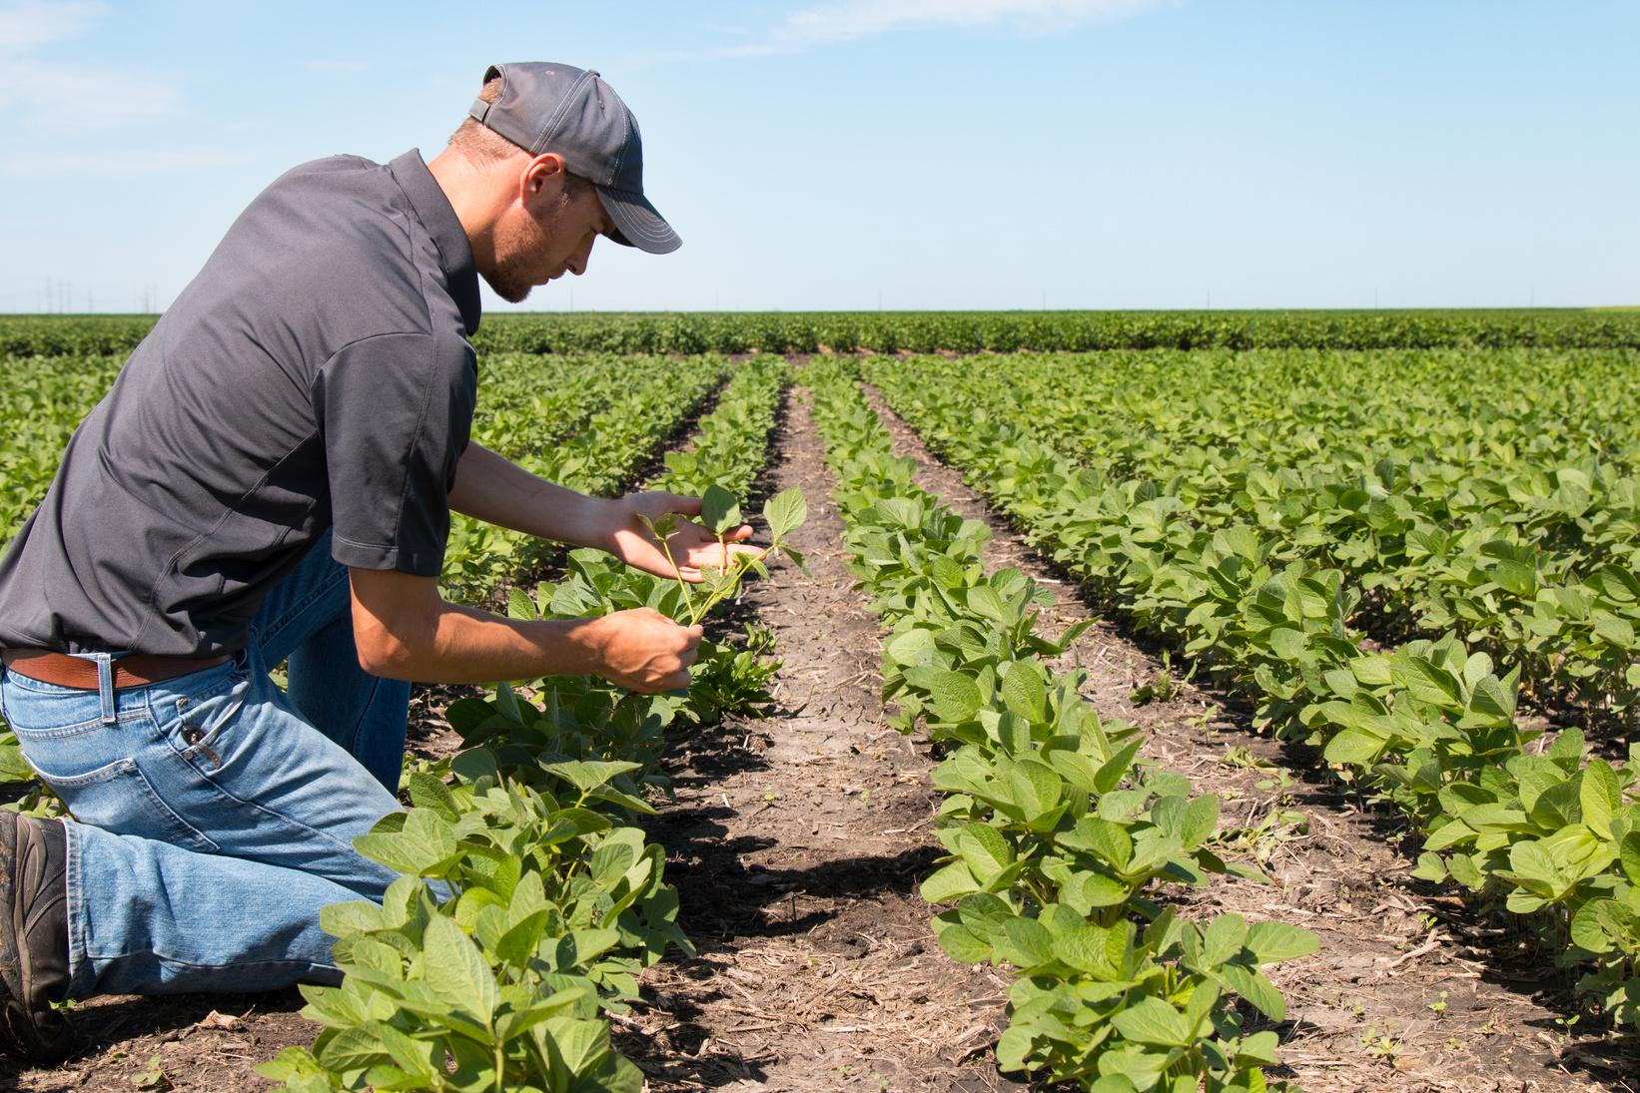

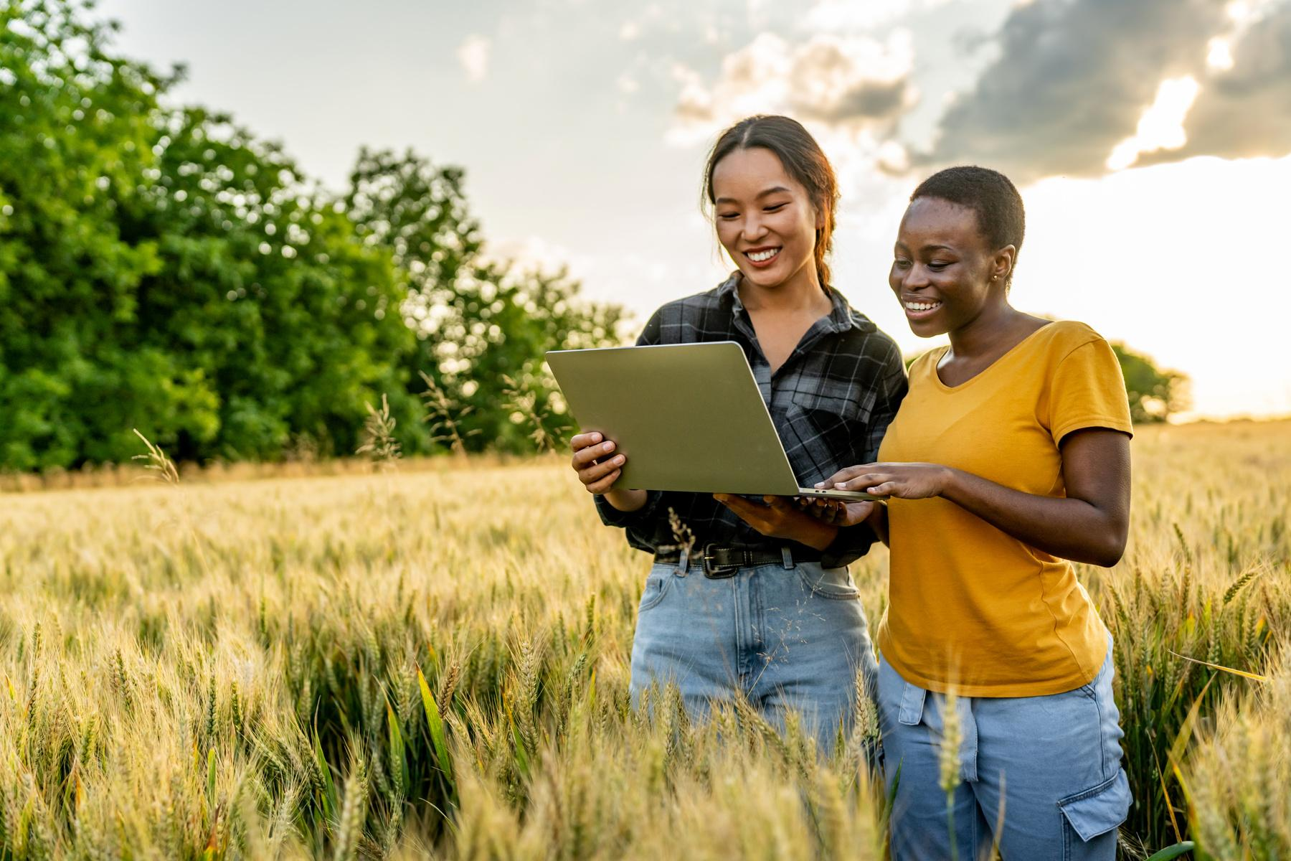
PROTOTYPE FEATURES
Tech Stack
Flask (Python) backend
Dummy model saved with PyTorch
Web-based UI for uploading leaf images
Easily expandable to real AI models and mobile platforms

Slide 6
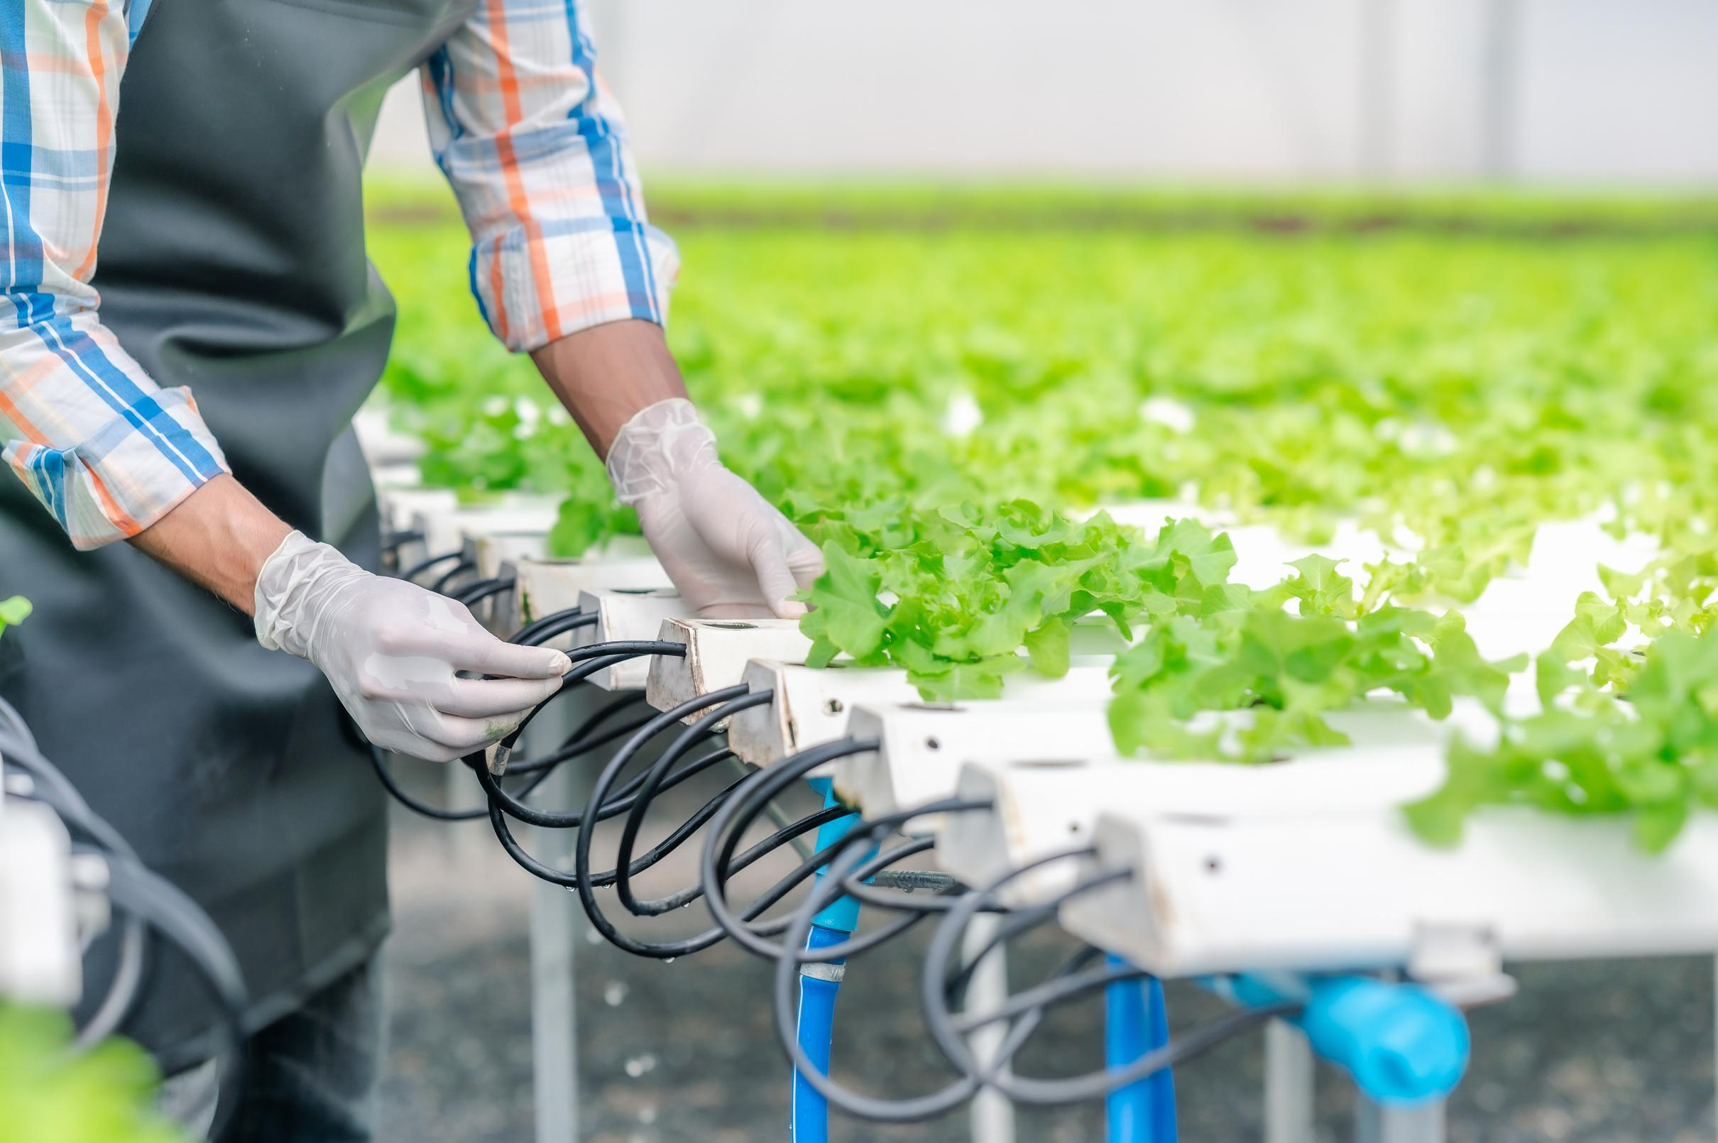
TARGET IMPACT
Who Benefits?
Smallholder and township farmers
Local agricultural cooperatives
Youth and women in rural areas

Slide 7
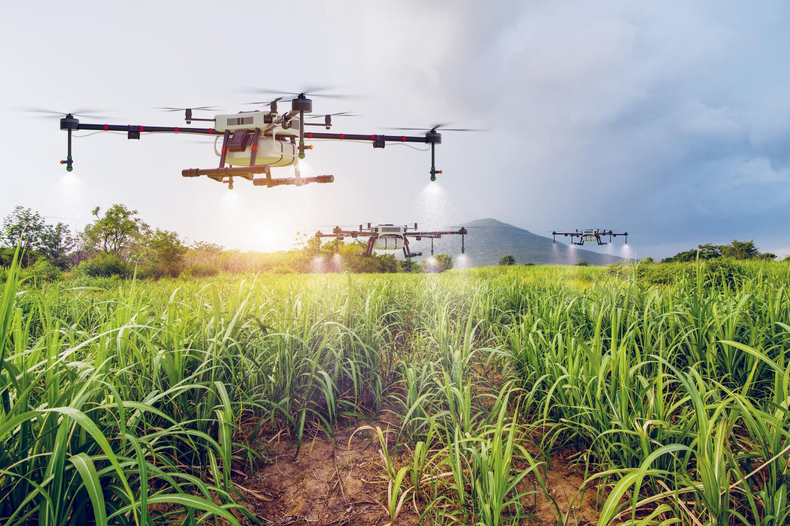


FUTURE PLANS
Next Steps
Train real model with plant disease dataset
Build mobile/SMS support for offline farmers
Partner with NGOs for field testing
Add multilingual and voice support

Slide 8


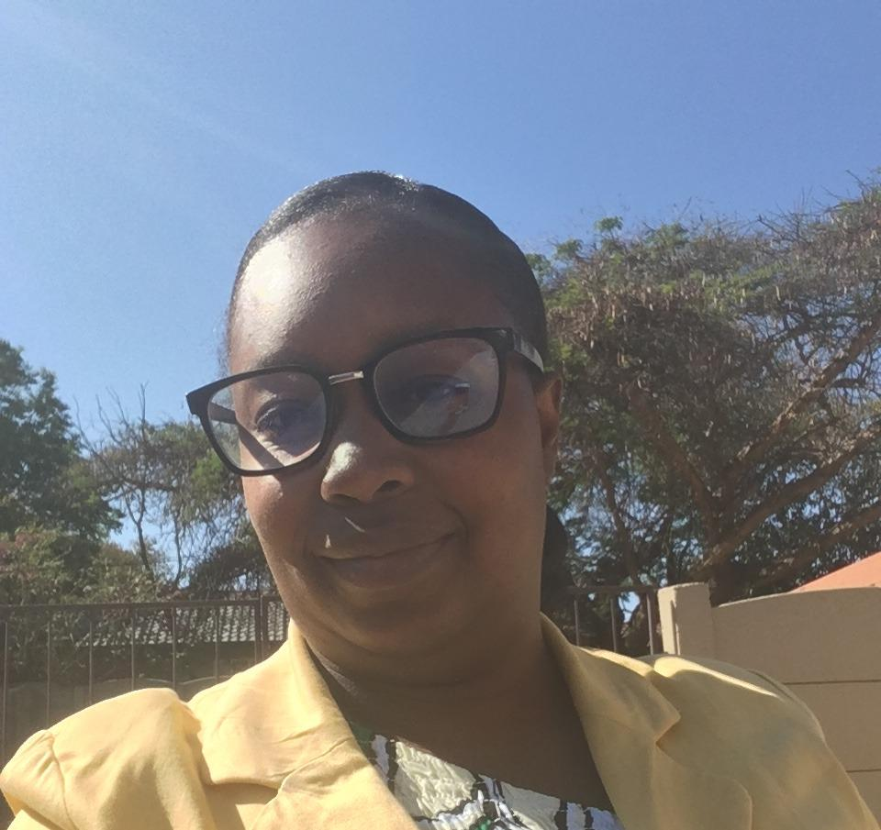
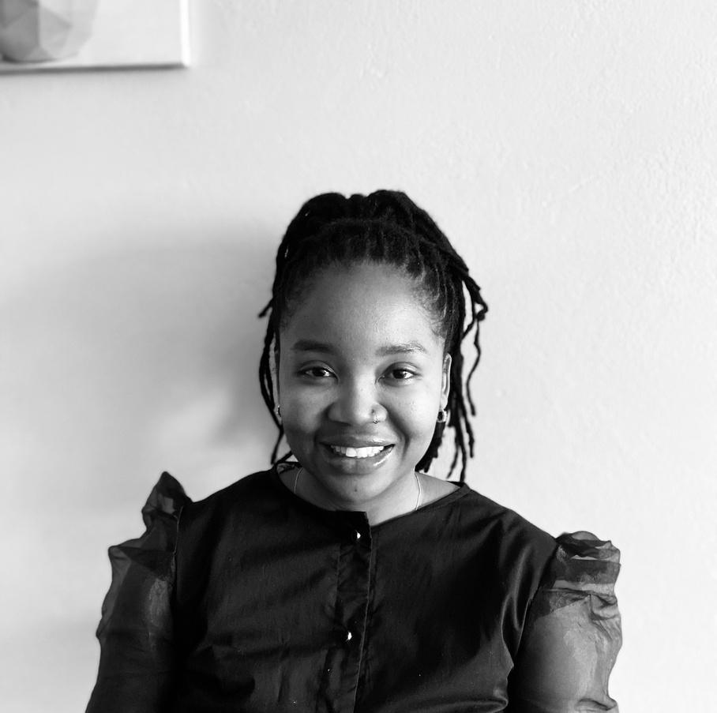
OUR BEST TEAM
Steven Asumba
Faith Tinarwo
Mpho Hlalele

Slide 9
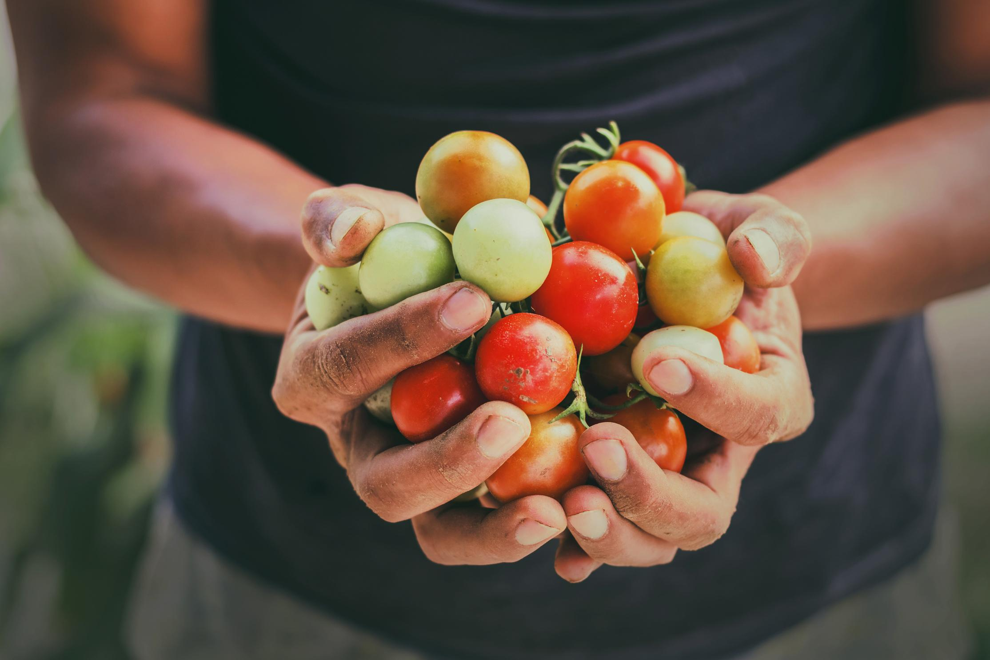

CALL TO ACTION:
Peer Review Requests
How can the app be more inclusive or user-friendly?
Feedback on expanding to real use cases or datasets
Suggestions on partnerships or testing strategies

Slide 10
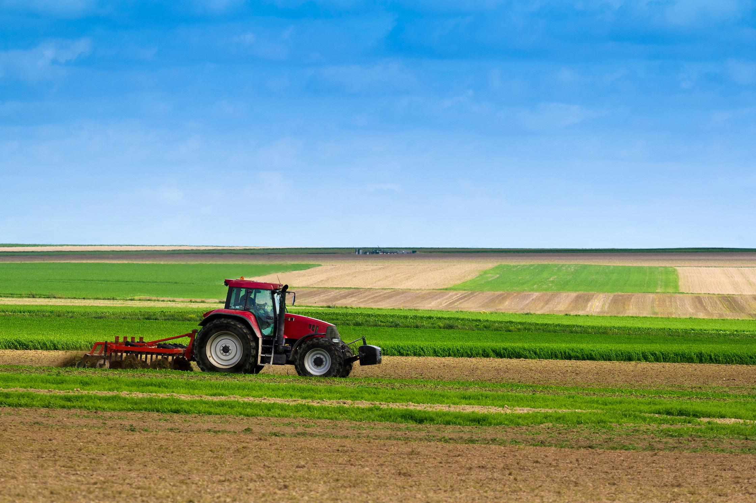

THANK YOU FOR REVIEWING LEAFGUARD

